Slide 1
Update 03.05.2018
mingleRNA

Slide 2

Work in progress – data sources
Parsing & Analyze: miRBase, deepBase, noncode, LNCpedia
New source: GENCODE
HUMAN: 15779 Long non-coding RNA genes
1881 miRNA genes
MOUSE: 12533 Long non-coding RNA genes
2202 miRNA genes

Slide 3
Work in progress – gene expression
add Data set:
E-GEOD-69637 - RNA-seq identifies novel lncRNAs involved in vascular smooth muscle cell proliferation
Raw data -> ENA
Diff expression workflow:
FPKM data (GEO + TCGA)
limma or edgeR
Statistics – Top diff expr genes
Convert data for our storage model

Slide 4
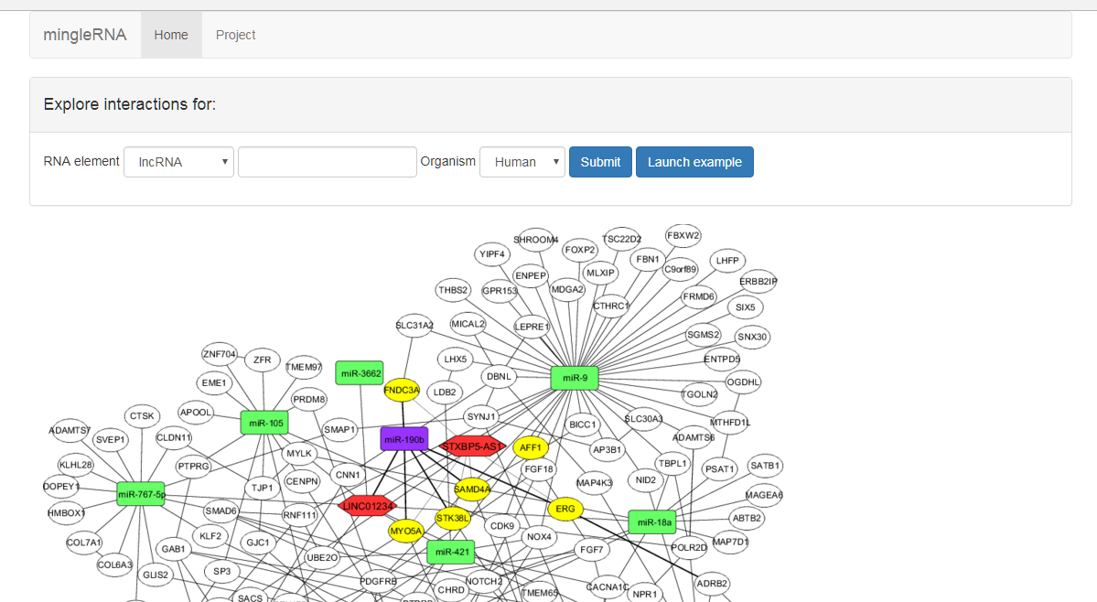
Work in progress – website – how will look

